Slide 1
CS/SE 611 Secure Web Design
Professor Lozada
7:30-10:20PM

Slide 2
Agenda
Roll call
Security Testing
Project Status Check
Lab Password Challenge

Slide 3
Security testing web applications
Information Gathering
Configuration Management Testing
Authentication Testing
Session Management Testing
Authorization Testing
Business Logic Testing
Data Validation Testing
Denial of Service Testing

Slide 4
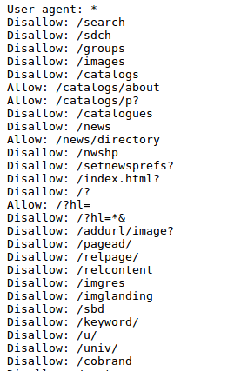
Spiders Robots and Crawlers
www.google.com/robots.txt

Slide 5
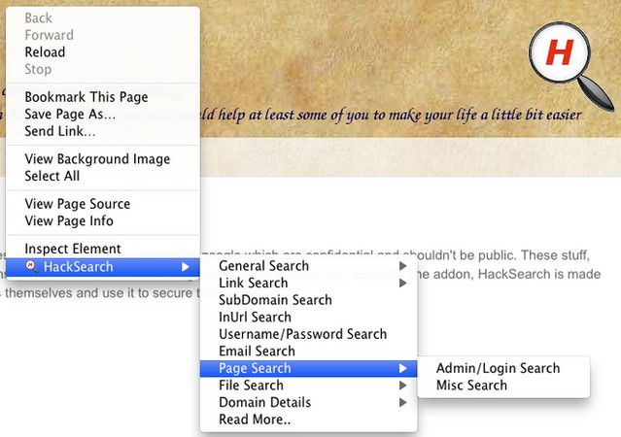
Search Engine Discovery
Google Hacking
site
cache
inurl
filetype
How to: Manual HackSearch

Slide 6
Identify Application Entry points
GET
POST
Cookies
Server Parameters
Files
How to:
Tamper Data, WebScarab, ZAP

Slide 7
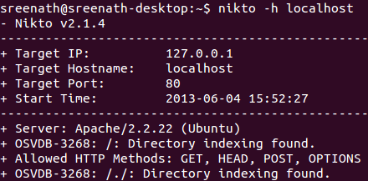
Web Application Fingerprinting
How to:
Nikto
Vulnerability Scanners

Slide 8
Application Discovery
Different Base URL
www.example.com/abc
Different port
www.example.com:8000
Different sub domain ( Virtual host )
abc.example.com
How to:
Zap, WebSlayer

Slide 9
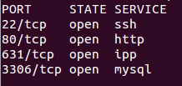
SSL Testing
Identify ssl ports and services How strong is you cipher?
How to:
Nmap -sV, Nessus, OpenSSL

Slide 10
Old, Backup & Unreferenced Files
User-agent: * Disallow: /Admin Disallow: /uploads Disallow: /backup Disallow: /~jbloggs
How to:
HackSearch, Webslayer

Slide 11

Testing for HTTP Methods
HEAD
GET
POST
PUT
DELETE
TRACE
OPTIONS
CONNECT
How to: Netcat Nikto

Slide 12
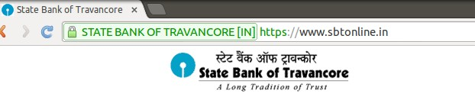
Credentials transport over an encrypted channel
Prevent man in the middle attack

Slide 13
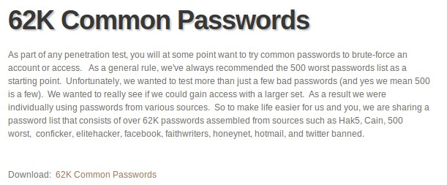
Testing for Guessable Users & BruteForce Attacks
How to:
John the Ripper Hydra

Slide 14
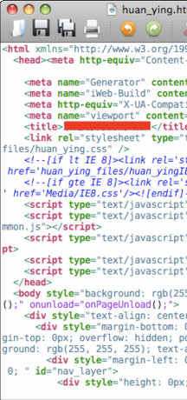
Searching for opportunities
View Source, and look for:
HTML comments
script code
other sensitive information in code: IP/email addresses, SQL queries, hidden fields,...
- watch HTTP requests/responses
look for hidden pages, files, parameters to target
- error messages sent to your browser by app
200: OK 400: Invalid request
403: Forbidden 404: File not found
500: Internal server error

Slide 15
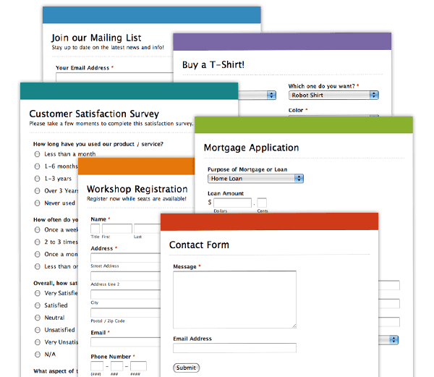
Input Forms
Forms let users pass parameters to the web server.
Parameters are passed using GET or POST requests.
GET: parameters are contained in the request URL.
http://www.google.com?q=Stephen+Colbert&lang=en
POST: parameters are contained in the HTTP packet header.
harder for the user to see, but no more secure than GET
Forms provide a rich attack ground...

Slide 16
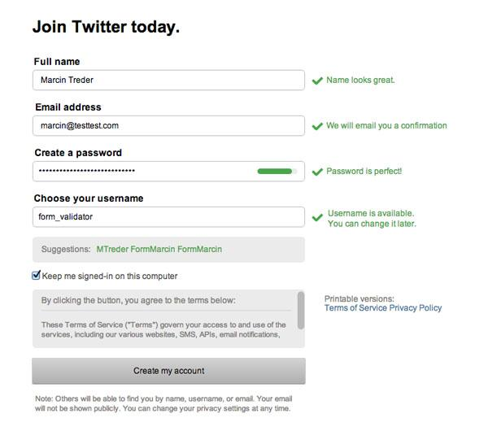
Form Validation
validation: Examining form parameters to make sure they are acceptable before/as they are submitted.
nonempty, alphabetical, numeric, length, ...
client-side: HTML/JS checks values before request is sent.
server-side: JSP/Ruby/PHP/etc. checks values received.
Some validation is performed by restricting the user's choices.
select boxes
input text boxes with maxlength attribute
key event listeners that erase certain key presses

Slide 17
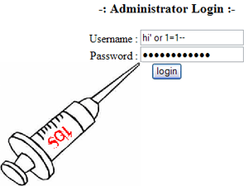
User Input Attacks
Bypassing client-side input restrictions and validation
maxlength limits on an input text field
choices not listed in a select box
hidden input fields
modifying or disabling client-side JavaScript validation code

Slide 18
Injection Types
SQL Injection
XSS Injection
LDAP Injection
XML Injection
HTML Injection
SSI Injection
ORM Injection
XPath Injection
IMAP/SMTP Injection
Buffer Overflow

Slide 19
SQL Injection
SQL injection: Causing undesired SQL queries to be run on your database.
-Often caused when untrusted input is pasted into a SQL query
PHP: "SELECT * FROM Users WHERE name='$name';";
specify a user name of: x' OR 'a'=‘a
SELECT * FROM Users WHERE name='x' OR 'a'='a';

Slide 20
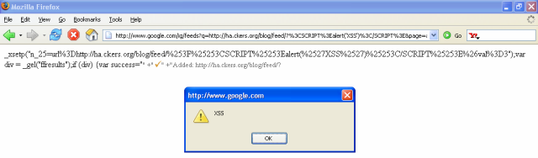
Cross-Site Scripting
cross-site scripting: Causing one person's script code to be executed when a user browses to another site.
Example: Visit google.com, but evil.com's JavaScript runs.
How attack is performed:
Attacker finds unsecure code on target site.
Attacker uses hole to inject JavaScript into the page.
User visits page, sees malicious script code.

Slide 21
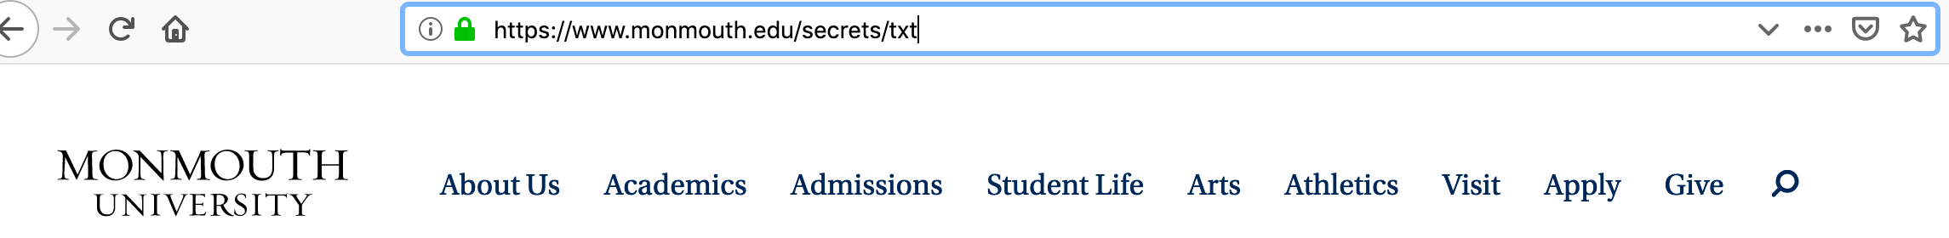
Guessing Files & Directories
Security through obscurity: Many reachable files/resources are hidden only by the fact that there is no link to them.
Try common file/folder/commands to see what happens:
/etc/passwd , /etc/shadow , cat, ls, grep
guess file names based on others
page11.php --> page12.php
loginfailure.jsp --> loginsuccess.jsp
accounts/fred.html --> accounts/sue.html
brute force / web spiders
port scanners

Slide 22
Other Common Attacks
Attacking GET parameters
Attacking hidden input fields
Attacking cookies
Cross-site request forgery (CSRF)

Slide 23
Open Source Tools
Nikto Nessus W3AF ZAP
WebSlayer Netcat Nmap Skipfish Hydra
Mozilla Firefox addons Lots & lots more...

Slide 24
Lab – Password Challenge
http://overthewire.org/wargames/natas/

